Slide 1

Adopted from MIT Course
KIRCHHOFF’S LAW
FISIKA DASAR 2

Slide 2
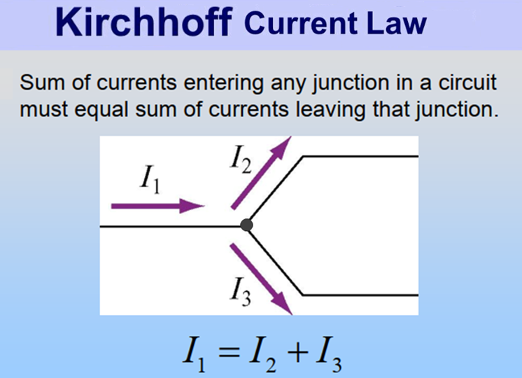

Adopted from MIT Course
2

Slide 3
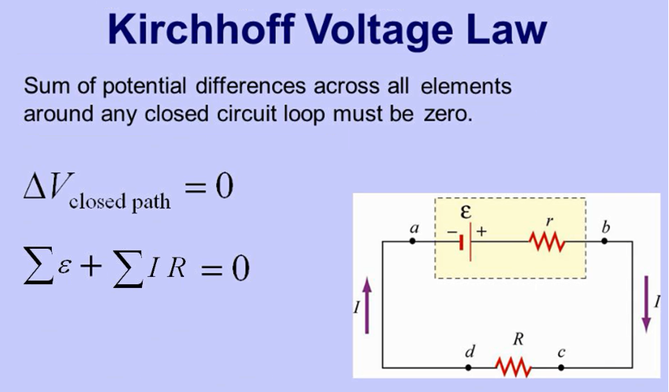
Adopted from MIT Course
3

Slide 4
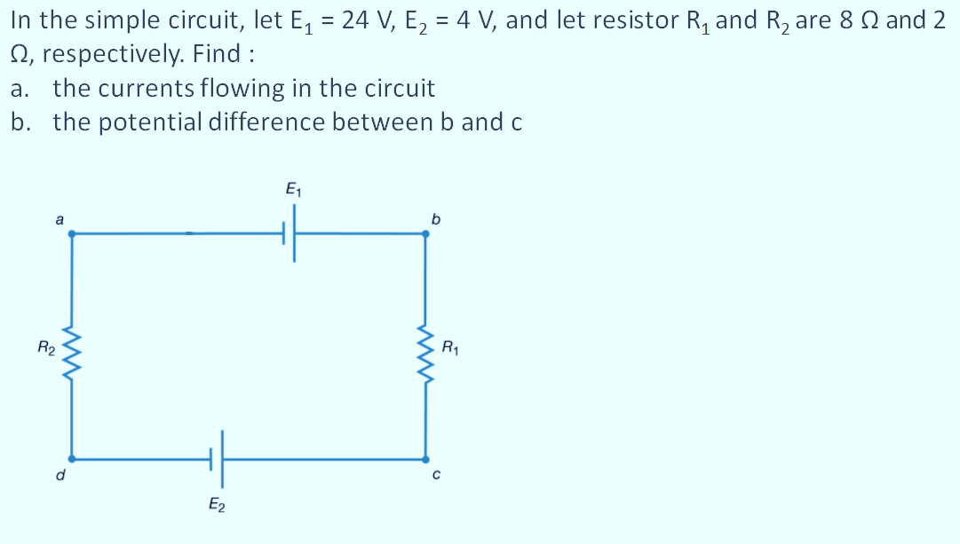
Example 1
4

Slide 5
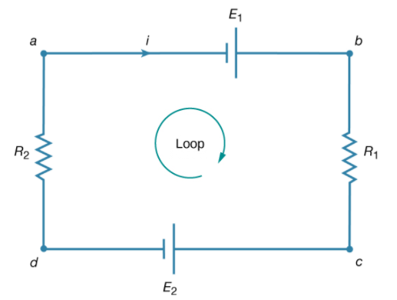
Solution
Pick directions for the currents and loop as shown in the diagram.
a) Use Kirchhoff Voltage Law
ΣE + ΣIR = 0
-E₁ + E₂ + I (R₁ + R₂) = 0
-24 + 4 + I (8 + 2) = 0
10 i = 20
i = 2 A
b) Use Ohm Law
V_{bc} = i R₁ = 2 × 8 = 16 V

Slide 6
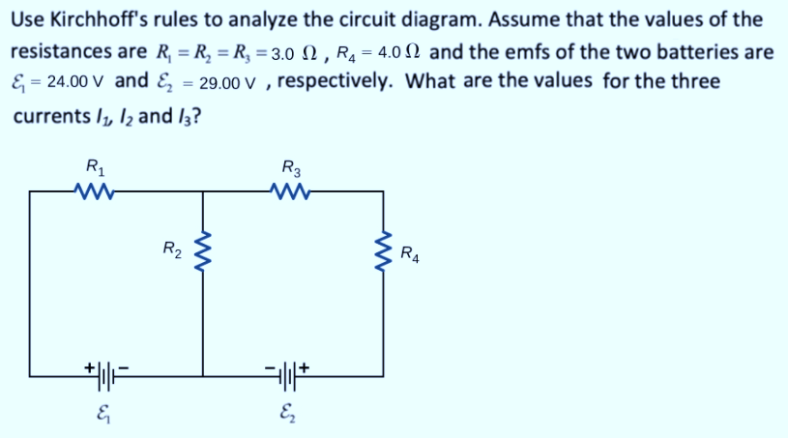
Example 2
6

Slide 7
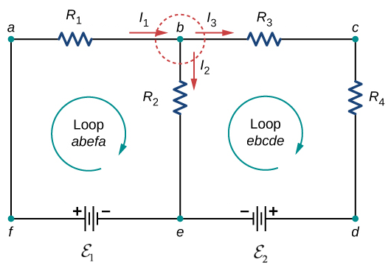
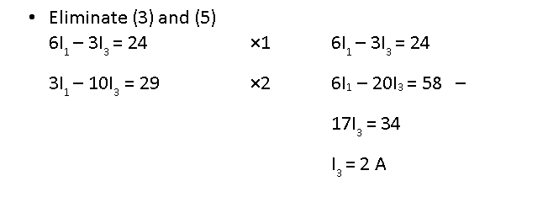
Solution
Label the circuit as shown in diagram
Apply Kirchhoff Current Law at junction b:
I₁ = I₂ + I₃
I₂ = I₁ – I₃ (1)
Apply Kirchhoff Voltage Law at loop abefa.
ΣE + ΣIR = 0
-E₁ + I₁R₁ + I₂R₂ = 0
I₁R₁ + I₂R₂ = E₁ (2)
Substitute (1) to (2):
I₁R₁ + (I₁ – I₃)R₂ = E₁
I₁(R₁ + R₂) – I₃R₂ = E₁
6I₁ – 3I₃ = 24 (3)
Apply Kirchhoff Voltage Law at loop bcdeb.
ΣE + ΣIR = 0
E₂ + I₃(R₃ + R₄) – I₂R₂ = 0
I₂R₂ – I₃(R₃ + R₄) = E₂ (4)
Substitute (1) to (4):
(I₁ – I₃)R₂ – I₃(R₃ + R₄) = E₂
I₁R₂ – I₃(R₂ + R₃ + R₄) = E₂
3I₁ – 10I₃ = 29 (5)
I₁ = 5 A
I₂ = 3 A
7

Slide 8
THANK YOU
8

